Slide 1
HPS Test Run Setup
Heavy Photon Search Collaboration Meeting
Thomas Jefferson National Accelerator Facility, May 26-27, 2011
Takashi Maruyama
SLAC

Slide 2
HPS Test Run Goals
Primary HPS Test Run Goals:
Measure Si sensor occupancies
Measure Ecal trigger rates.
Secondary objectives:
Track finding efficiencies and purities
Momentum and vertex resolution
Efficient trident trigger development
Fully Commissioned Test Run Apparatus can do physics
Search for heavy photons in the parameter space domain favored by a “heavy photon” explanation of the muon g-2 anomaly.
Search in the “vertexing” domain.

Slide 3
Layout of HPS test setup in Hall B

Slide 4
HPS Test Run Setup

Slide 5
Magnet, Target and Beam
Full HPS
HPS Test Run
18D36 Magnet with 14” gap
Magnetic field: 1 Tesla
2.2 GeV 200 nA and 6.6 GeV 450 nA
Target 0.125% X₀ (2.2 GeV), 0.25% X₀ (6.6 GeV)
Beam spot ∼20 μm
Target rotates continuously.
18D36 Magnet with 8” gap
Magnetic field: 0.5 Tesla
2.2 GeV 200 nA
1.1 GeV 50 nA possible if 1.1 GeV is available for Hall B.
Target 0.125% X₀
Stationary target
Beam σ_{x} ∼200μm at the target to avoid excessive heating, while σ_{y} ∼20μm for precision vertexing.

Slide 6
The flat beam has been demonstrated.

Slide 7
Tracker
Full HPS
HPS Test Run
Designed tracker first, then increased 18D36 Magnet gap to 14”.
Use 8” gap 18D36 Magnet, and design tracker around it.
 | Layer 1 | Layer 2 | Layer 3 | Layer 4 | Layer 5 | Layer 6
Z (cm) | 10 | 20 | 30 | 50 | 70 | 90
Stereo angle | 90 deg | 90 deg | 90 deg | 50 mrad | 50 mrad | 50 mrad
 | Layer 1 | Layer 2 | Layer 3 | Layer 4 | Layer 5
Z (cm) | 10 | 20 | 30 | 50 | 70
Stereo angle | 100 mrad | 100 mrad | 100 mrad | 50 mrad | 50 mrad
Total 106 sensors
Total 20 sensors
Compact tracker, but the tracking
capability is not compromised.
Tracker acceptance is 1/3 of full HPS tracker.

Slide 8
Tracker layout
Test run configuration
Target at the edge of the magnet yoke.
While layers #1-#5 are in an uniform field, the field at the target is ~15% lower.
Tracking in non-uniform field has not been done.
The field becomes more uniform if the target and tracker are moved downstream by 10cm.
But this move requires significant modifications in the Ecal design.
We will stick with the target and tracker locations.
Tracking in non-uniform field needs to be implemented. We have to do this in the full experiment anyway, and we should learn it from the test run.
Tracker length is 60 cm.
Δp/p ∼ 1/L (multiple scattering limited).
Tracker acceptance << 1/L²
Target
#1
#2
#3
#4
#5
Magnet

Slide 9
Tracker Layer #1 Occupancy
Target thickness dependence
Geant 4 predicts 2x occupancy.
Occupancy is 1% in 7.5 ns time window
with 0.125% X₀.
One of the primary goals of the test run is to measure the occupancy.

Slide 10
Multiple Scattering in Thin Target
θ
x2 difference

Slide 11
Tracker Acceptance
Test run tracker acceptance: ∼1/3 full HPS acceptance.
Preferentially accept this topology.
2.2 GeV beam
0.5 Tesla field
1.1 GeV beam and 0.25 Tesla would shift the acceptance peak by -25 MeV.

Slide 12
Ecal
Design criteria: highest acceptance with available crystals
460 PbWO₄ Crystals (2 top and bottom segments, 5 rows of 46 crystals)
Ecal enclosure will be designed so that no modification is required for the full HPS.
Lead-glass modules or additional PbWO₄ Crystals will be added for the full HPS.
The front flange, the vacuum chamber inside Ecal, and the downstream beampipe are new.

Slide 13
Ecal Vacuum Chamber

Slide 14
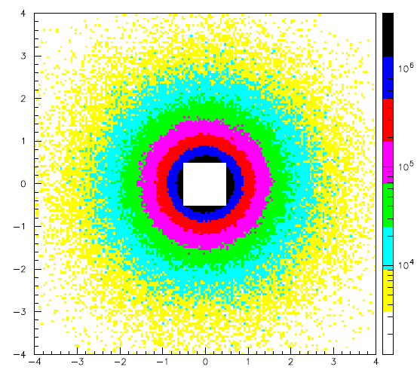
Ecal crystal occupancy
At face of Ecal (z=137 cm)
# e-/sec@200nA/0.5x0.5mm²
More than 100 MeV Edep in 8 ns time window
G4
14.6 mrad
19.3 mrad
Y (cm)
24.1 mrad
+1/2 crystal
+1 crystal
X (cm)

Slide 15
Detector configuration
Detector configuration, alignment and design are tightly coupled.
We need to check every details before we start cutting metals.
Target
Ecal
Frascati
18D36
Frascati
Flange
γ
γ dump
e-
Beam position and angle at the target define everything.
Move 18D36 Magnet ∼9cm horizontally (Magnet will not be rotated)
Photon beam is centered wrt the magnet at the exit.
The flange must accommodate both HPS beam and straight beam.
Tracker is aligned to the photon line.
30 mrad off
Position and angle of both e- and γ at Ecal are critical as the Ecal front flange is attached to the magnet.
Ecal will not be rotated, but the crystals will be aligned to the photon line.

Slide 17
Tracker Alignment and Adjustability
A’(50) in Layer #1
How can we align the tracker?
How many degrees of remote adjustment do we need?
Alignment tolerance
Vertically ~50 μm
Horizontally ~1 mm
100 mrad
Y (cm)
X (cm)

Slide 18
Any showstoppers?
X-ray from the target
Low energy e+/e- and photons from off-energy e⁻s hitting the vacuum chamber or downstream beampipe.
Neutrons from off-energy e⁻s hitting the vacuum chamber, and from the photon dump
Pions
π⁰ can generate trigger.
σ_{TOT}(γ(4.9-5.5 GeV)+Pb →π⁰ + x) = 12 μb
Charge exchanged π⁺ can be like e- in Ecal
Synchrotron radiations
Photons from Frascati magnet in the stereo sensors
Photons from the y-focusing quad.
Beam gas scattering in the upstream beamline
Coulomb scattered or bremsstrahlung e- from residual gas.
Beam halo

Slide 19
Conclusions
The HPS Test Run design is progressing rapidly.
Now is the time to check every details.
Any features or diagnostic devices deemed necessary must be reflected in the design.

